Slide 1
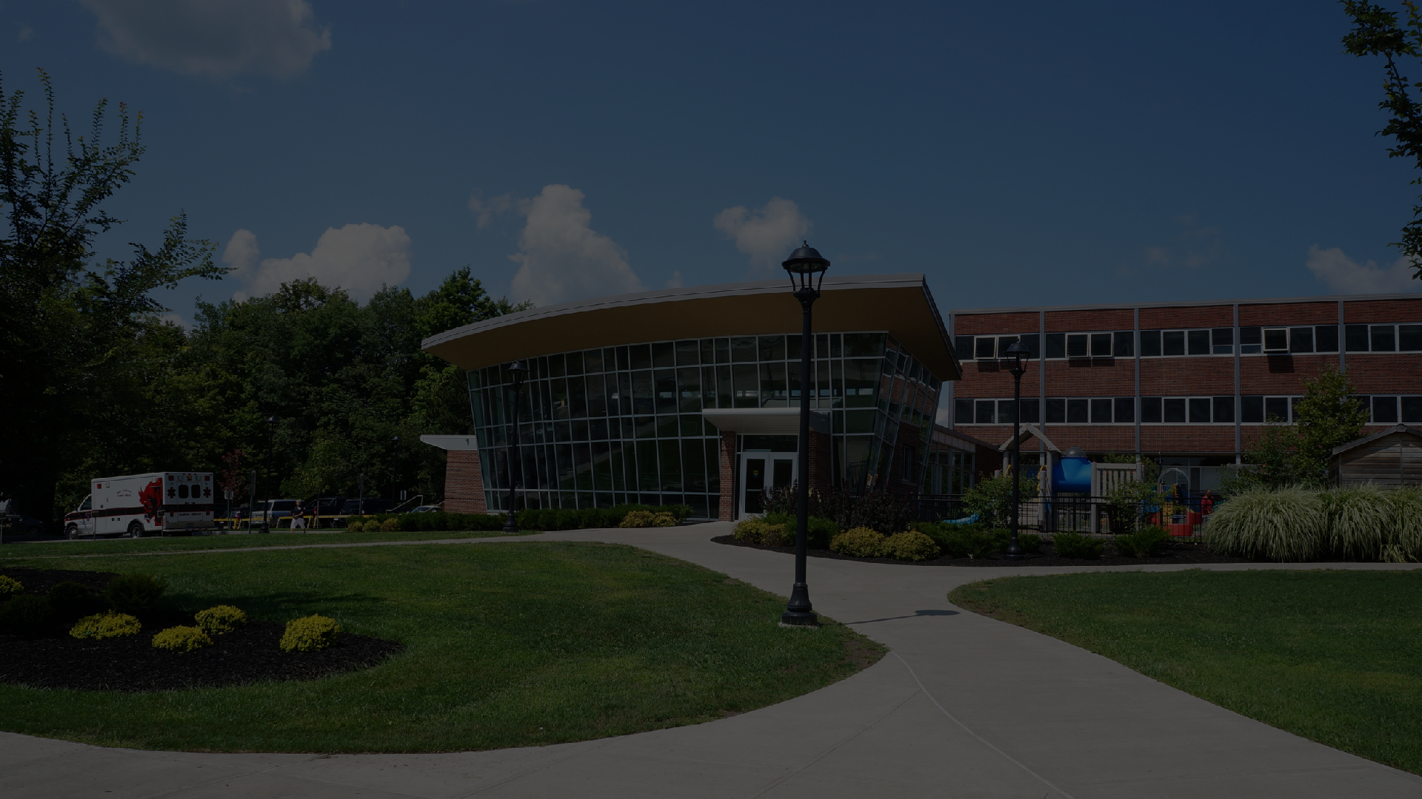
N
R
O
I
M
N
I
G
S
C
A
B
OL
A
L
G
E
N
G
A
E
B

Slide 2
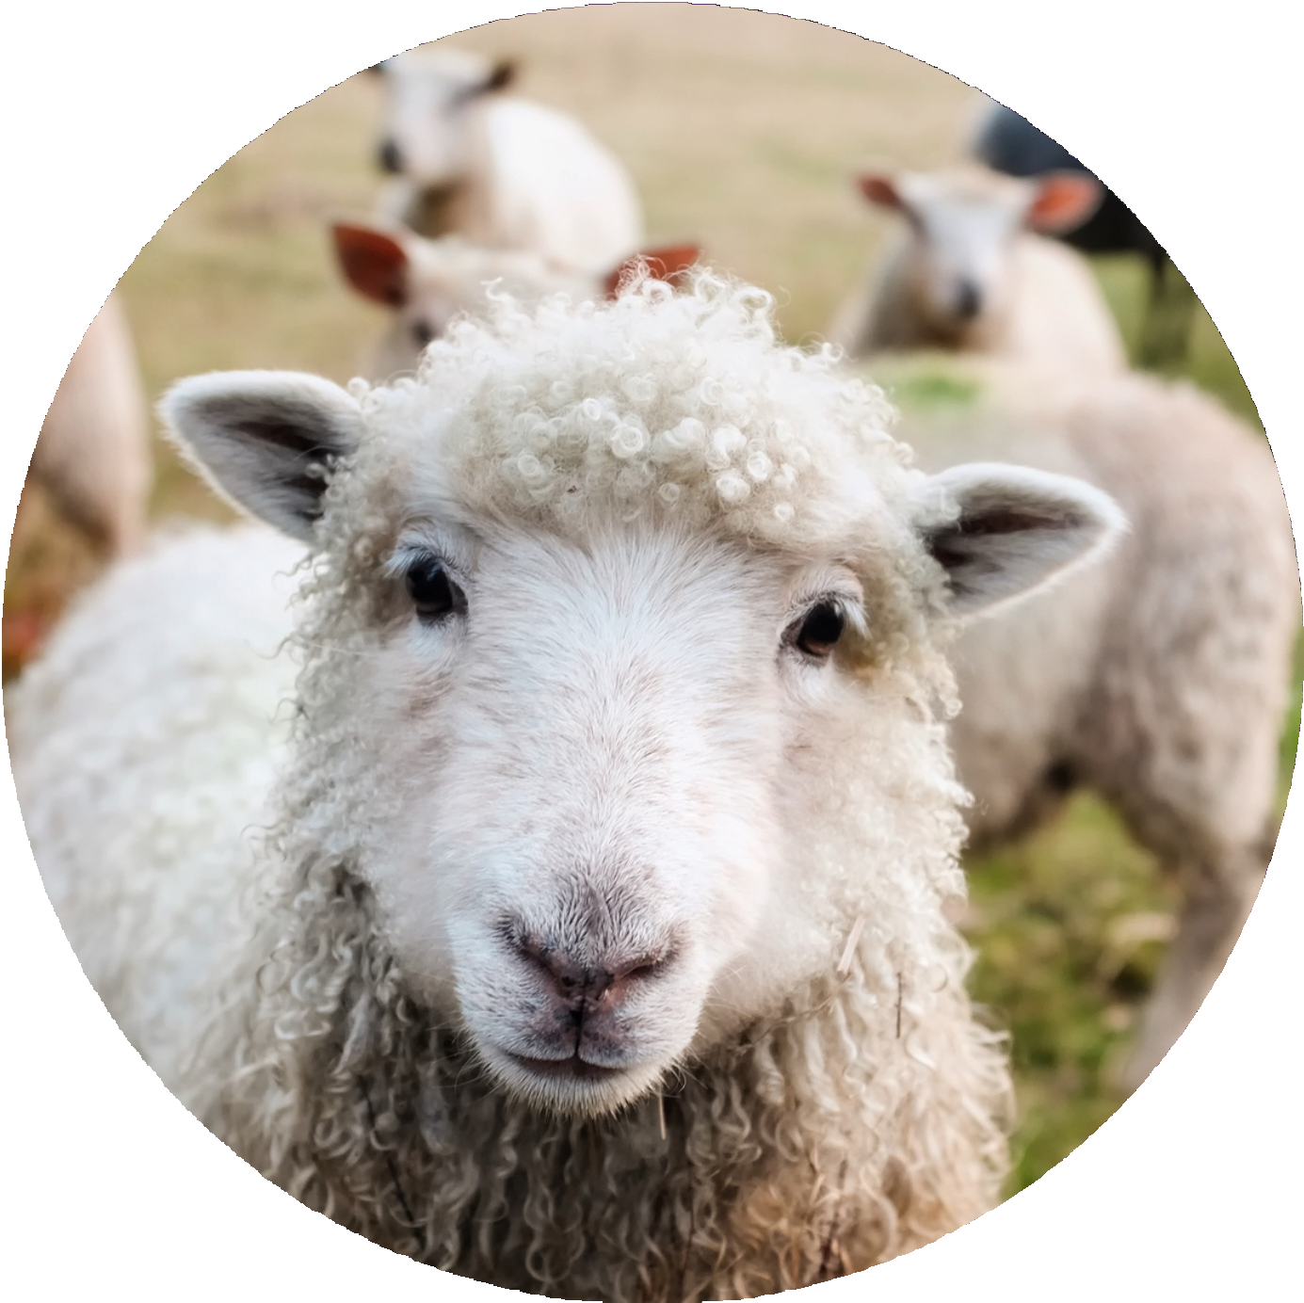
F A
O
N
I
N
M
O
A
I
L
T
C
A
L
IC
O
L
N
P
I
P
N
A
G

Slide 3
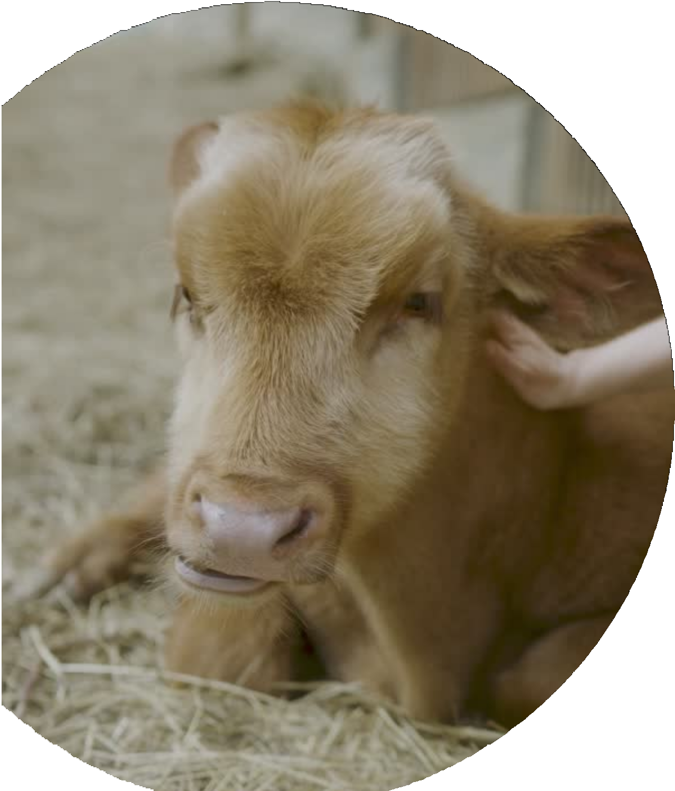
AnimaL cLoning is the process of creating geneticaLLy identicaL copies of animaLs.
DU
O
C
R
T
T
I
N
O
I
N
1.
The first successfuL animaL cLoning experiment was carried out in 1996 by researchers
DoLLy was the first mammaL to be cLoned using a technique caLLed somatic ceLL nucLear transfer,scnt
Embryo spLitting technique

Slide 4
1.
G
B
N
E
I
N
N
E
O
F
L
I
C
T
S
.
Preservation of endangered species:
Improvement of Livestock breeds:
DeveLopment of transgenic animaLs for medicaL research
Reproducing animaLs that are difficuLt to breed naturaLLy

Slide 5
5.
Increasing genetic diversity in popuLations:
6. Saving criticaLLy endangered species:

Slide 6
CA
L
I
T
L
I
P
O
P
N
A
A
C
M
L
I
O
N
N
A
I
F
N
O
G
1.
Livestock Improve ment
2.
Transgenic AnimaL Production
3.
Reproduction of endangered species:

Slide 7
CA
L
I
T
L
I
P
O
P
N
A
A
C
M
L
I
O
N
N
A
I
F
N
O
G
4
MedicaL
research:
5
Disease
resistance
6
Organ transpLantation

Slide 8
CA
L
I
T
L
I
P
O
P
N
A
A
C
M
L
I
O
N
N
A
I
F
N
O
G
8.
Studying genetic diseases
7.
Genetic
modification

Slide 9
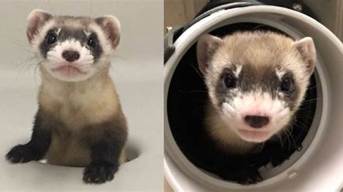
R
E
S
G
P
N
E
E
C
D
I
N
E
E
S

Slide 10
LIVESTOCK IMPROVEMENT

Slide 11
Animal cloning can be a useful tool in improving livestock breeds by reproducing animals with desirable traits and increasing productivity and profitability for farmers. Here are some ways in which animal cloning can be beneficial for livestock breeding

Slide 12
INCREASING PRODUCTIVITY
Cloning can also be used to increase the productivity of livestock. By cloning an animal that produces high yields of milk or meat, farmers can produce more of these animals without having to go through the time-consuming process of breeding. This can lead to increased productivity and profitability for farmers.

Slide 13
GENETIC PRESERVATION:
Cloning can also be used to preserve the genetics of endangered or rare breeds. By cloning an animal that belongs to a rare breed, farmers can ensure that the genetics of that breed are preserved for future generations. This can help to prevent the loss of valuable genetic resources and maintain biodiversity.

Slide 14
DISEASE RESISTANCE:
Cloning can also be used to produce animals with resistance to specific diseases. By cloning animals that have demonstrated resistance to certain diseases, farmers can produce offspring that are also resistant. This can reduce the risk of disease outbreaks and the need for expensive veterinary treatments.

Slide 15
TRANSGENIC ANIMAL PRODUCTION

Slide 16
Animal cloning can be a powerful tool for producing transgenic animals with specific genetic modifications for medical research purposes. By modifying the genetic material of an animal, researchers can create animal models that mimic human diseases and conditions, allowing them to study the mechanisms of these diseases and develop new treatments and drugs.
One way that animal cloning can be used for medical research is by producing animals with specific genetic modifications that are known to cause human diseases. For example, researchers can create animals with mutations in genes that are associated with cancer, Alzheimer’s disease, or cystic fibrosis. By studying these animals, researchers can gain insight into how these diseases develop and test potential treatments.
Another way that animal cloning can be used for medical research is by creating animal models that are specifically designed to test new drugs and treatments. For example, researchers can clone animals with a specific genetic mutation and then test potential drugs or treatments to see how they affect the animal’s condition.
This can help researchers identify potential new therapies and determine the most effective dosages and treatment regimens.

Slide 17
Animal cloning can also be used to produce animals with human genes, allowing researchers to study the effects of human genes in a controlled animal model. This can be especially useful for studying complex genetic diseases that are difficult to study in humans.
In addition to its potential uses in medical research, animal cloning also has important applications in agriculture, conservation, and the production of livestock. For example, researchers can use animal cloning to create genetically modified livestock that are resistant to disease or produce higher yields of meat or milk.
However, it is important to note that animal cloning raises ethical concerns, including the welfare of the cloned animals and the potential for genetic engineering to be used for purposes beyond medical research. As such, animal cloning should be conducted with careful consideration of the ethical implications and with appropriate regulatory oversight.

Slide 18
R
L
E
A
S
C
E
I
A
D
R
E
C
M
H
Cloning can be used to create genetically identical animals for medical research, such as testing new drugs and treatments.

Slide 19
R
E
S
E
I
S
S
A
T
E
A
S
N
I
C
D
E
Cloning can be used to create animals that are resistant to certain diseases, which can help to prevent the spread of these diseases.

Slide 20
S
N
P
A
L
R
A
T
N
T
N
A
A
T
G
I
R
O
O
N
Cloning can be used to create animals with organs that are genetically identical to those of humans, which can be used for organ transplantation.

Slide 21
Cloning can be used to modify the genetic makeup of animals, which can lead to the development of new medicines and therapies.
OD
M
I
F
C
I
I
C
T
A
E
T
N
I
E
O
G
N

Slide 22
E
N
T
E
I
G
G
C
D
N
I
I
S
Y
E
D
A
U
S
T
E
S
S
:
Cloning can be used to create animal models of genetic diseases, which can be used to study these diseases and develop treatments.

Slide 23
AnimaL cLoning raises a number of ethicaL concerns, particuLarLy regarding animaL weLfare and potentiaL risks to human heaLth and the environment.
NS
O
I
C
D
E
L
R
A
A
C
T
I
I
H
O
T
N
E
S
AnimaL weLfare is a major ethicaL consideration in animaL cLoning How ?
1 2 3
many faiLed attempts
suffer from birth defects
iLLnesses, and other heaLth probLems.

Slide 24
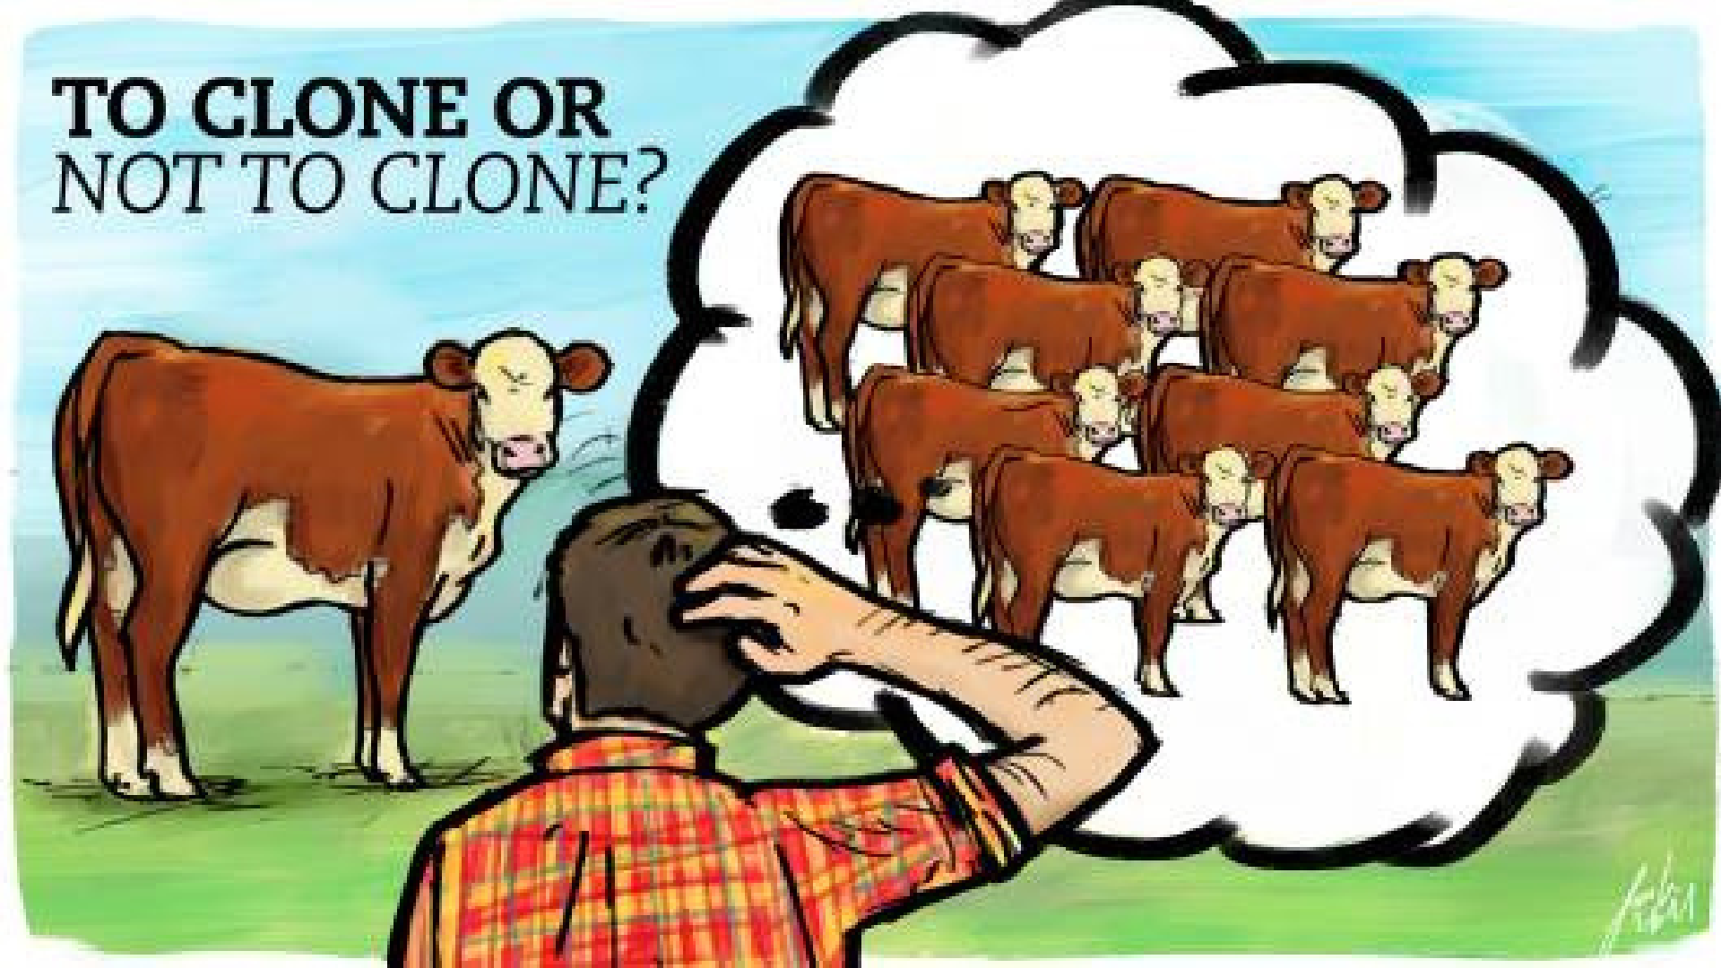

Slide 25
CONCLUSION
Animal cloning can be a valuable tool in improving livestock breeds by reproducing animals with desirable traits, increasing productivity and profitability for farmers, preserving rare genetics, and producing animals with disease resistance. However, it is important to use cloning in a responsible manner and to ensure that animal welfare is always a top priority.

Slide 26
ACKNOWLEDGEMENT
I would like to thank my Zoology teacher, Dr. Sreejata Biswas mam, Mr Sujoy Sarkar, Mr Anirban Ray,Mrs Priya Bhowmick for guiding me throughout this powerpoint presentation. A special acknowledgement goes to our principal Dr. Amitava Dutta who gave me the golden opportunity of this wonderful work, which also helped me in doing a lot of research and I came to know about so many new things. I wish to thank my friends as well for their support and encouragement without which I could not have completed this project in the limited time frame. In the end, I want to thank my parents who displayed appreciate for my work and motivated me to continue my work.

Slide 27
Preservation of endangered species: “AnimaL CLoning: The Science of NucLear Transfer” by Jose B. CibeLLi, et aL.
RE
E
N
F
C
E
E
R
1.
_{2.} : “CLoning WiLd Life: Zoos, Captivity, and the Future of Endangered AnimaLs” by Carrie Friese
3.
“The Ethics of Animal Cloning” by John Harris and Karen McMillan
4.
https:// googLe.com

Slide 28
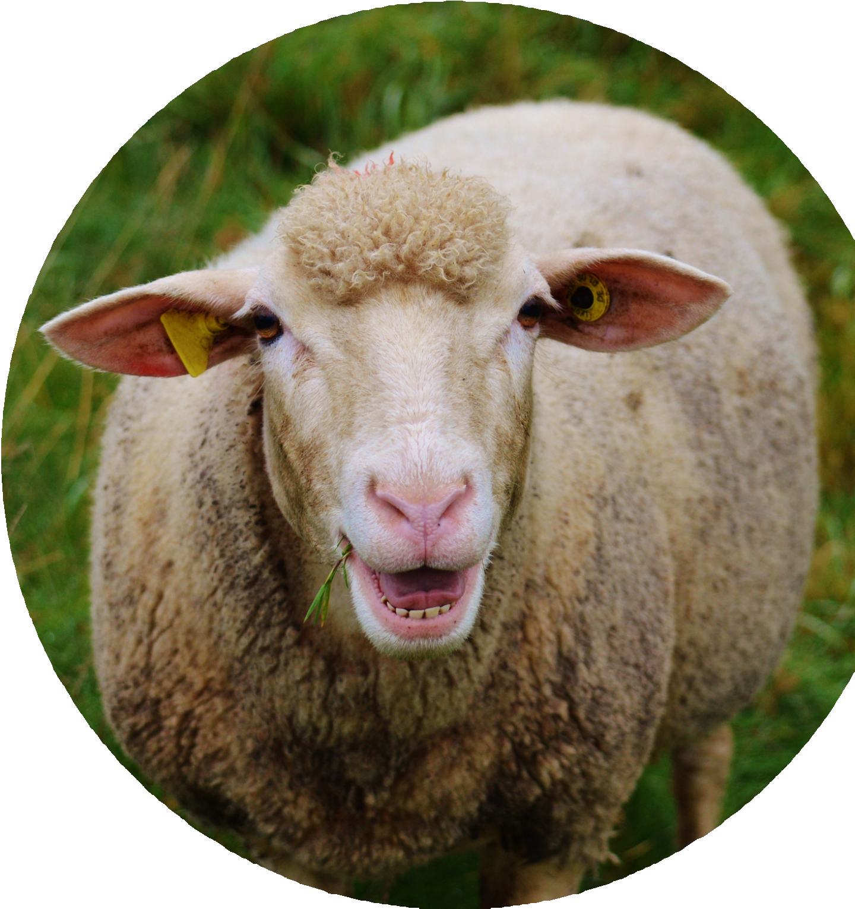
K
N
Y
A
O
H
U
T
!
DO YOU HAVE ANY QUESTIONS FOR ME BEFORE WE GO?

Slide 29
A
P
T
I
E
C
N
I
T
A
R
M
A
E
P
1.
MURTAZA AHMED SIDDIQUEI *
2.
SUBIR CHAKRABORTY
3.
MONIDIPA MISHRA
4.
SUSHOBAN DEY

Slide 30
